Slide 1
DATS 6401 Data Visualization Project
Data Visualization for Healthcare, Education and Military spending for top ten G-20 countries.
1

Slide 2
Overview
Data Source – The Organization for Economic Co-operation and Development (OECD) and World Bank Data bank.
Got G-20 countries data from OECD and World Bank.
Narrow down the selection to top ten countries in Healthcare, Educational and Military spending.
Time Limit: I Used six years of data from 2010 to 2015 for my data analysis.
Used Google API, Bar charts, Geo Maps, Stacked Bar Chart, Time series Line Chart and Pie charts to visualize my data.
Conclusion
2

Slide 3
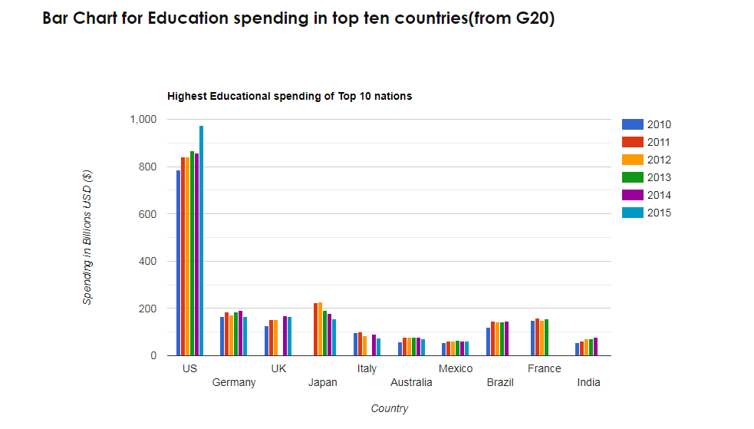
Bar chart for Military spending
3

Slide 4
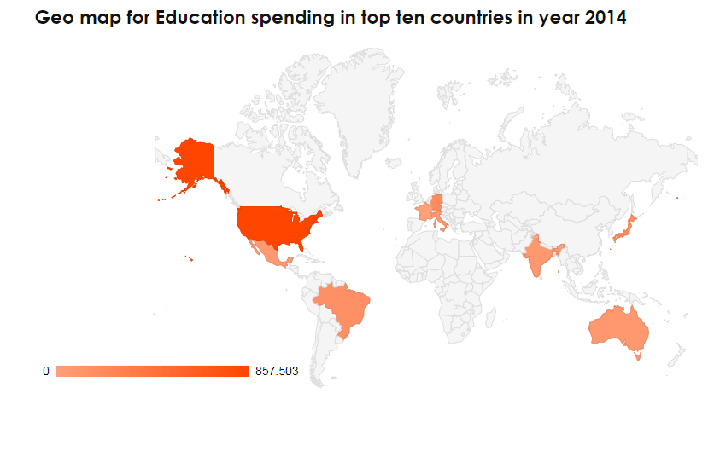
Military spending in Time series without USA
4

Slide 5
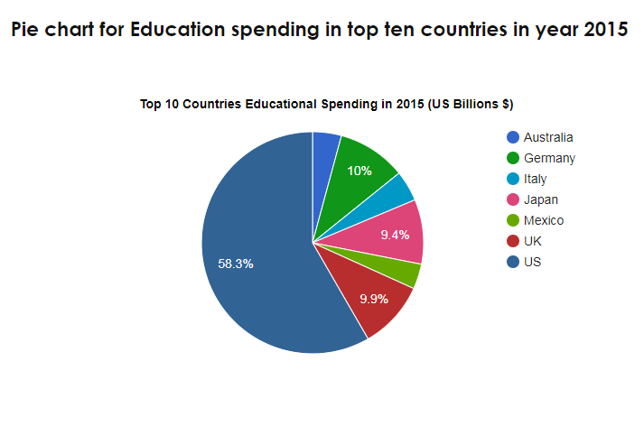
5

Slide 6
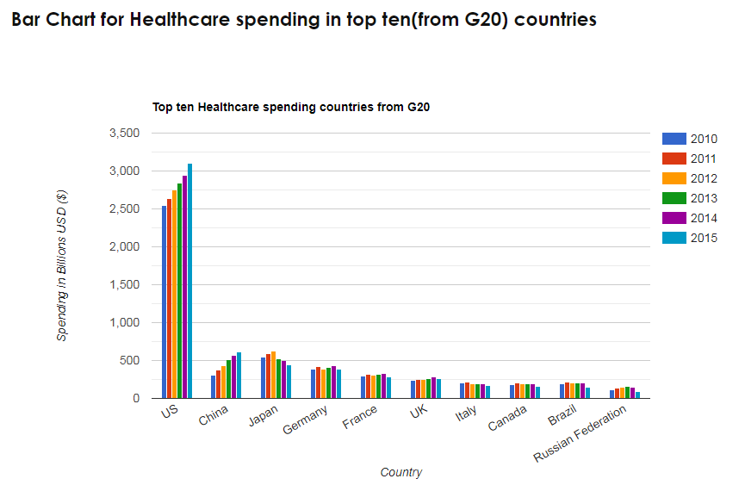
6

Slide 7
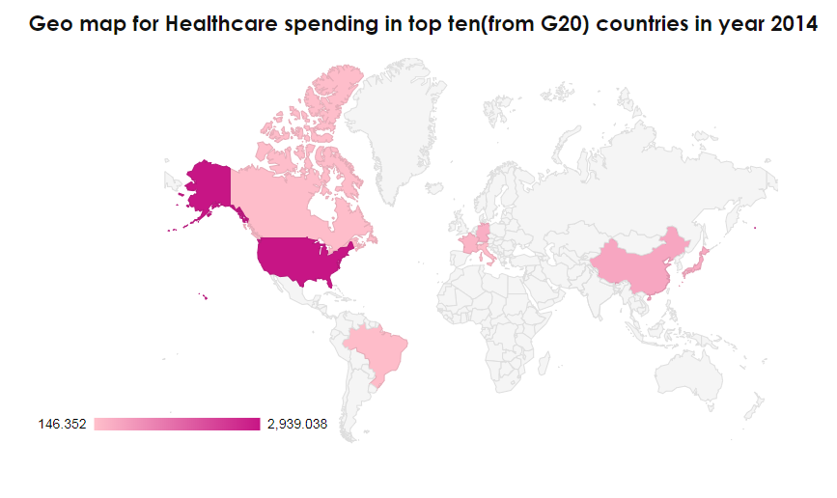
7

Slide 8
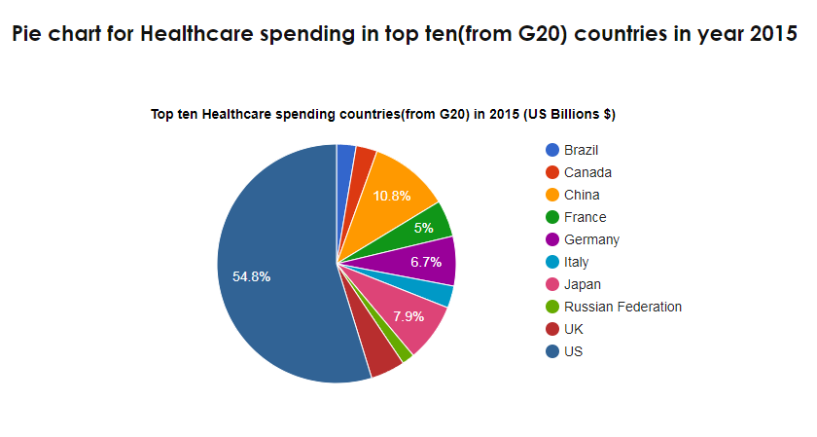
8

Slide 9
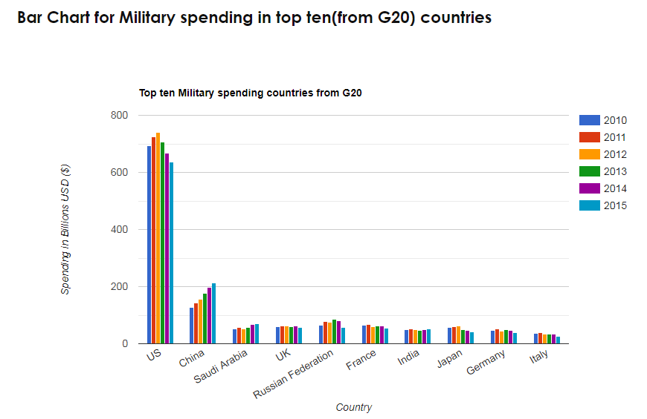
9

Slide 10
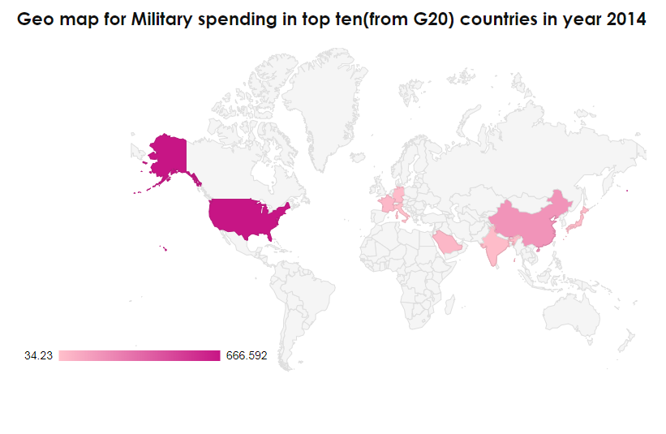
10

Slide 11
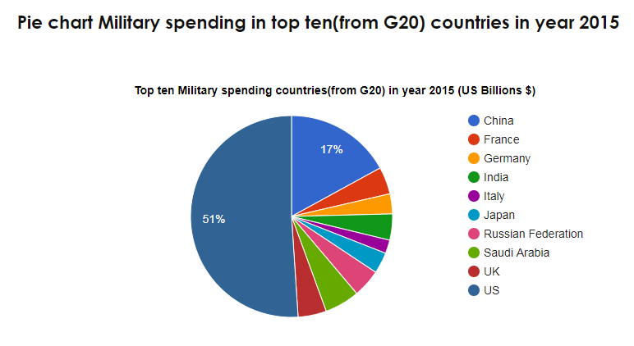
11

Slide 12
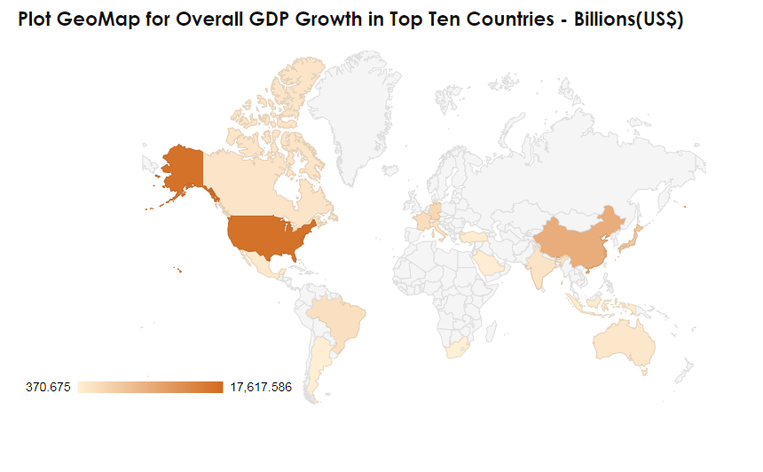
12

Slide 13
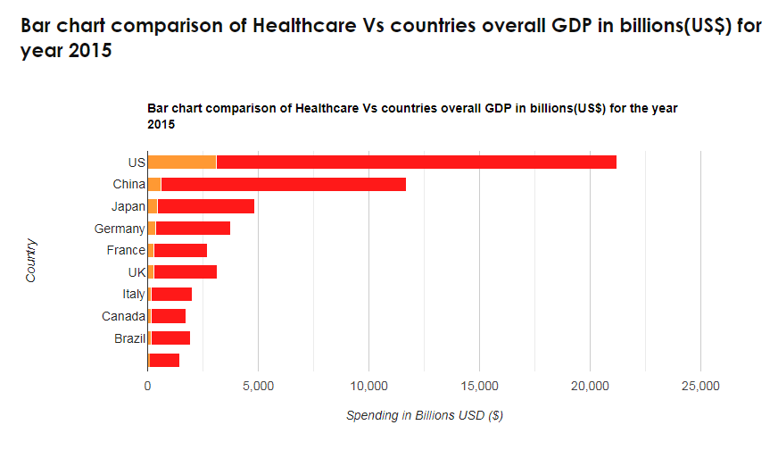
13

Slide 14
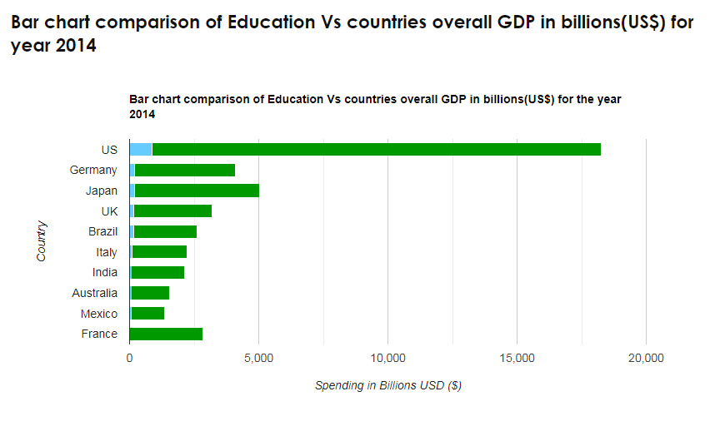
14

Slide 15
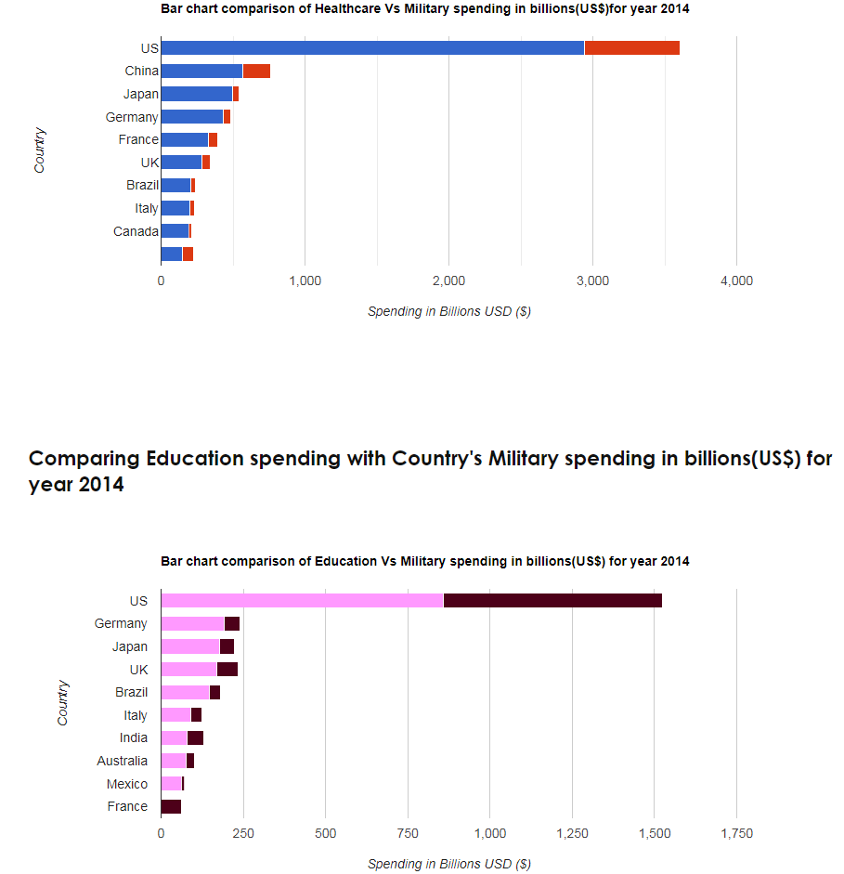
15

Slide 16
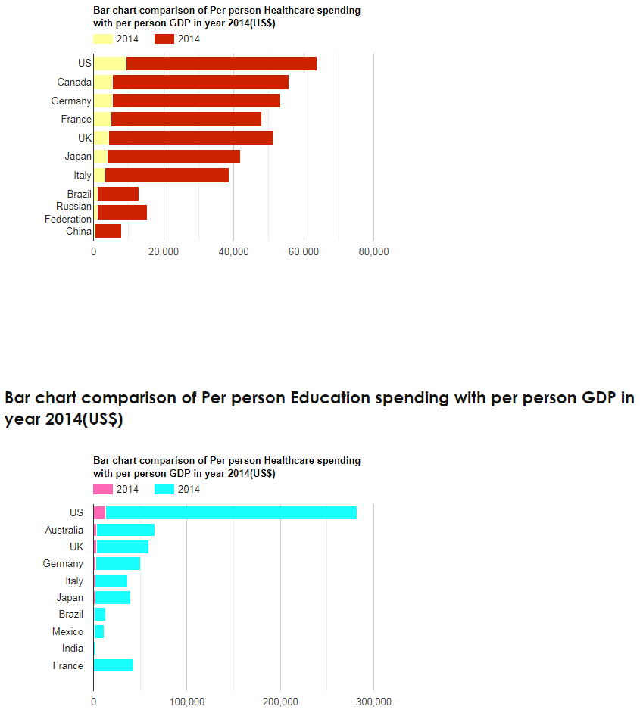
16

Slide 17
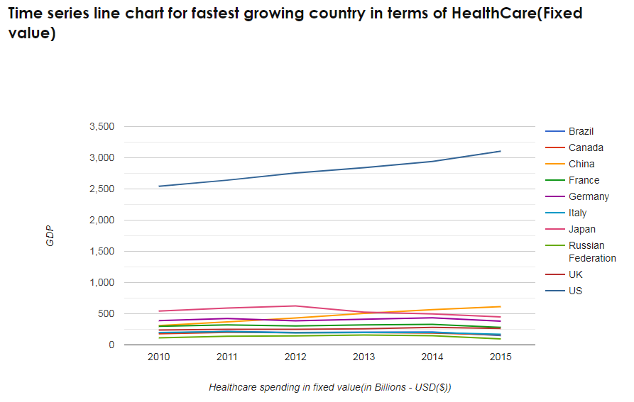
17

Slide 18
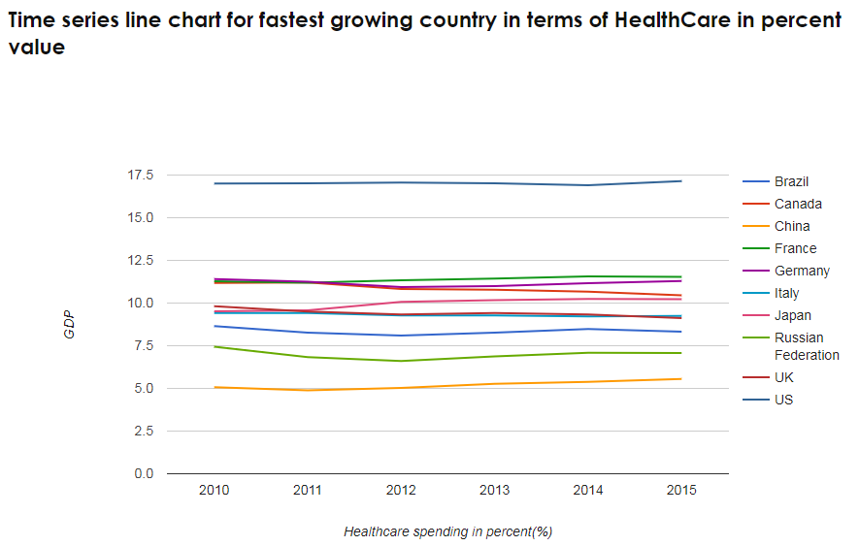
18

Slide 19
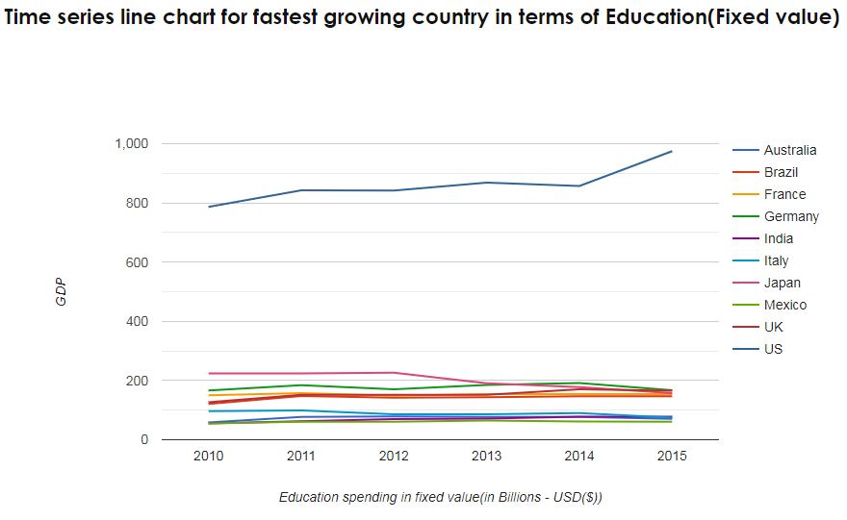
19

Slide 20
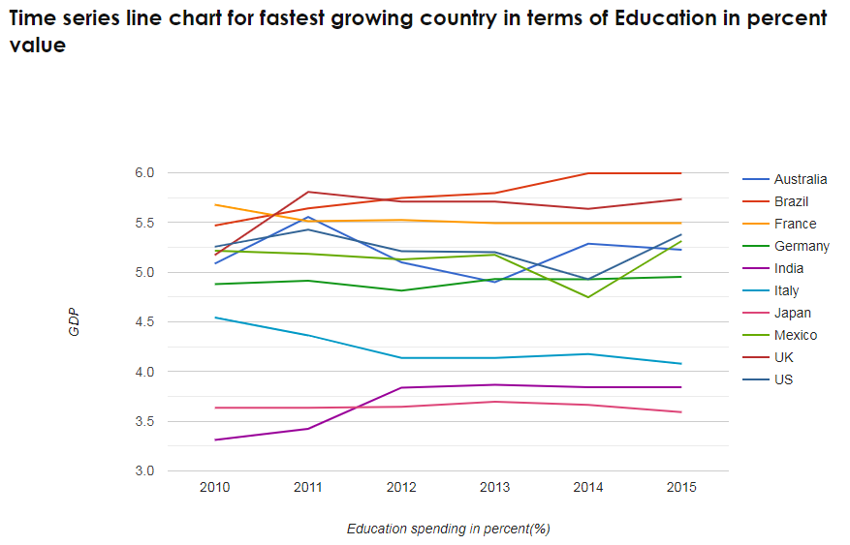
20

Slide 21
Conclusion
The United States of America ranks highest in Education(975 Billions), HealthCare(3106 Billions), Military(635 Billions) spending and in GDP(16,473 Billions)
When we compare per person Healthcare spending with per person GDP - Canada, Germany, UK stands next to USA.
When we compare per person Education spending with per person GDP - Australia, UK , Germany and Japan stands next to USA.
In terms of percent spending on Education Brazil ranks the highest - 5.99 percent of the total GDP
In terms of percent spending on Healthcare USA ranks the highest - 17.1 percent of the total GDP
21

Slide 22


